Slide 1
Automatic exam essay grader with artificial intelligence feedback
By: Joseph Egan
C20389531

Slide 2
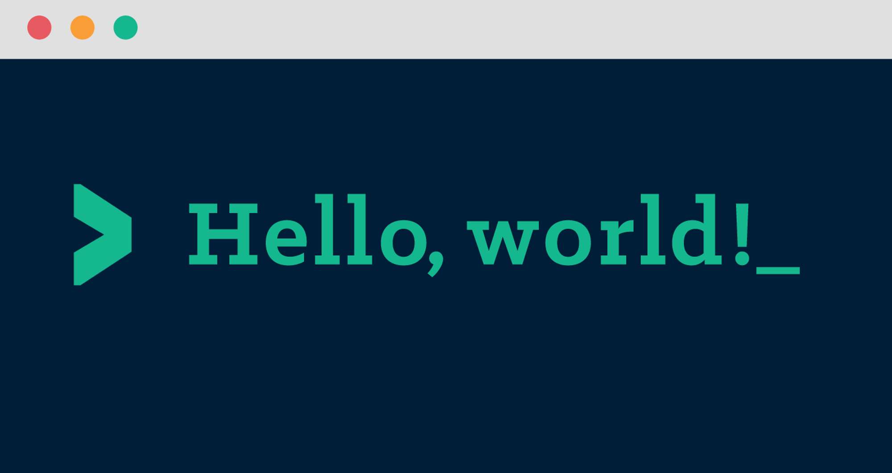
Introduction
Who am I?
Demonstrate the machine model creation
Demonstrate usage of model

Slide 3
Refresher on Project
What is my project?
Machine learning model with AI feedback.
Used for practice exam papers
Model used to grade the essay
AI used to generate feedback
User Interface
Section to chose paper the user is submitting.
Drop box or other user input system
Machine Learning model
Document Processing.
Interperting grading rubric and loading model.
Artificial Intelligence
Generationg personalised feedback for results.
Outputing results and feedback to user.
Grading paper.

Slide 4
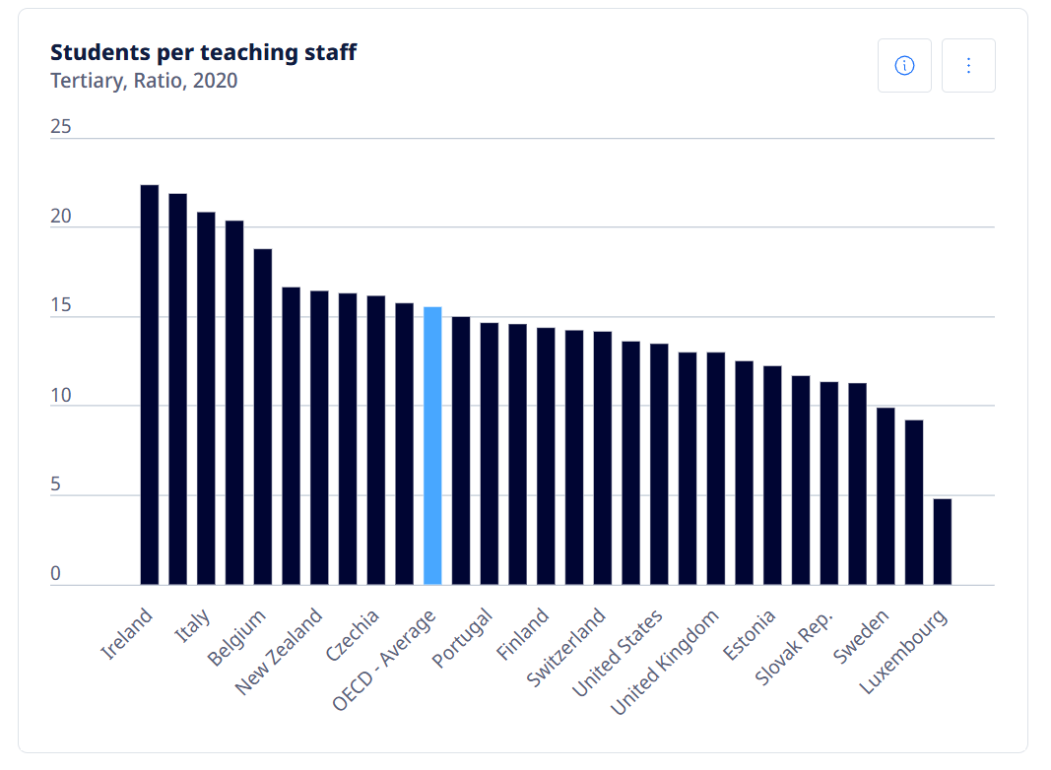
Purpose of Project
Student assistance
Lecturer assistance
Organisation for Economic Co-operation and Development
Ireland 22.38:1 student to lecturers, United States 13.63, UK 13.50, OECD average 15.58
Source(https://www.oecd.org/en/data/indicators/students-per-teaching-staff.html?oecdcontrol-8476e61c3c-var6=TRY)

Slide 5
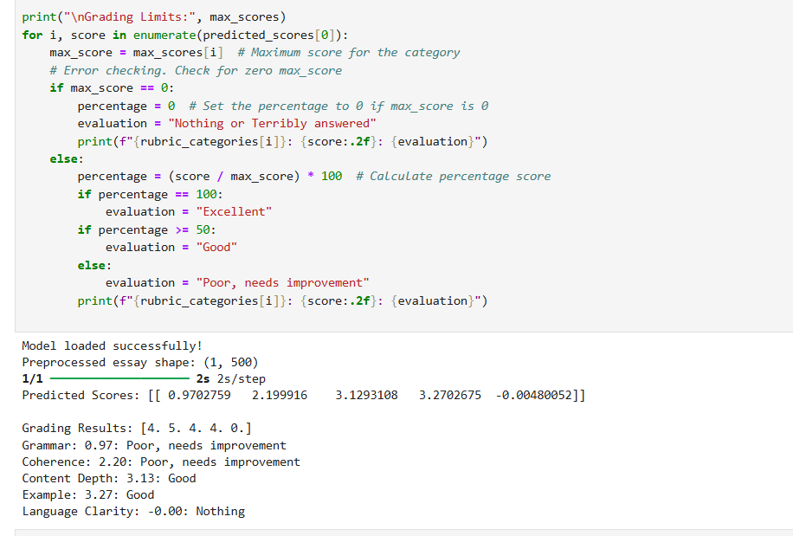
Unique Selling Point
Hybrid-approach
Machine Learning Model
Artificial Intelligence
Human readable feedback

Slide 6
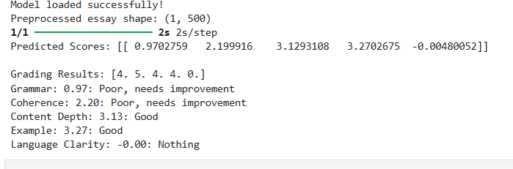
Problems
Problem of machine learning models?
Problem of artificial intelligence
Problem of a one-size-fits-all

Slide 7
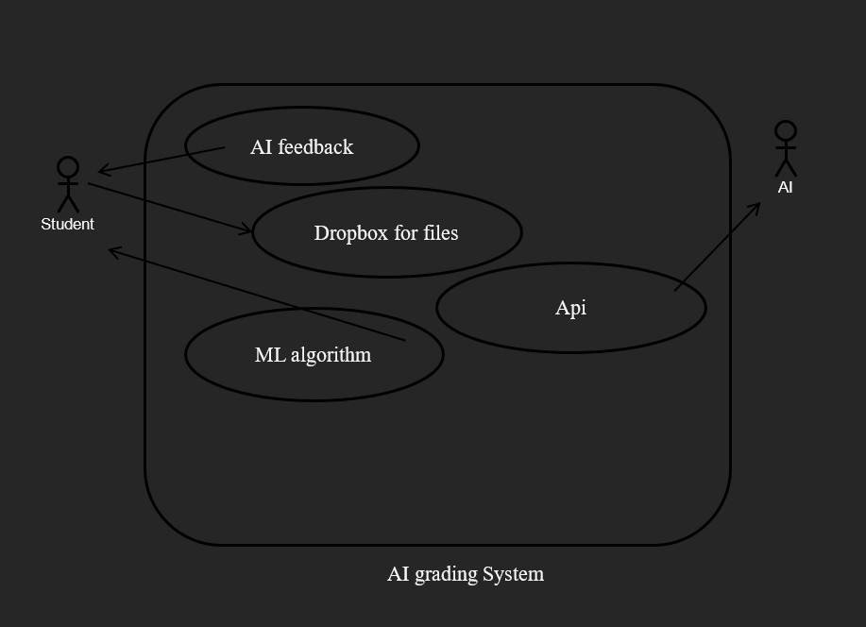
Project overview
Users
Exam paper Models
Grading rubric
AI feedback

Slide 8
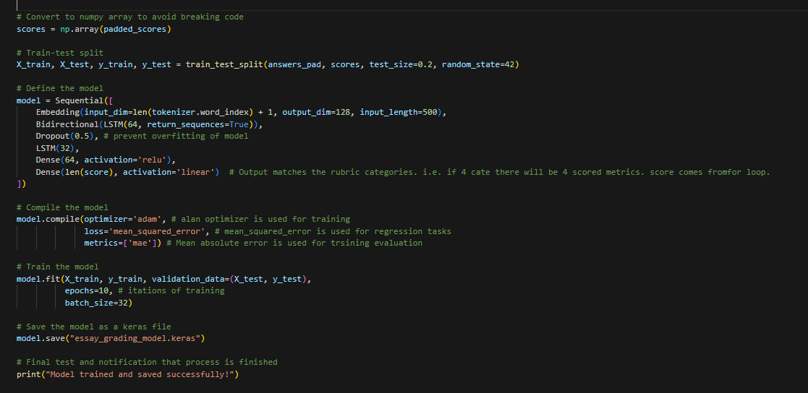
Model Creation part 1
How to create a model?
load_answers_from_docs()
train_test_split()
Model .compile() .fit() .save()

Slide 9
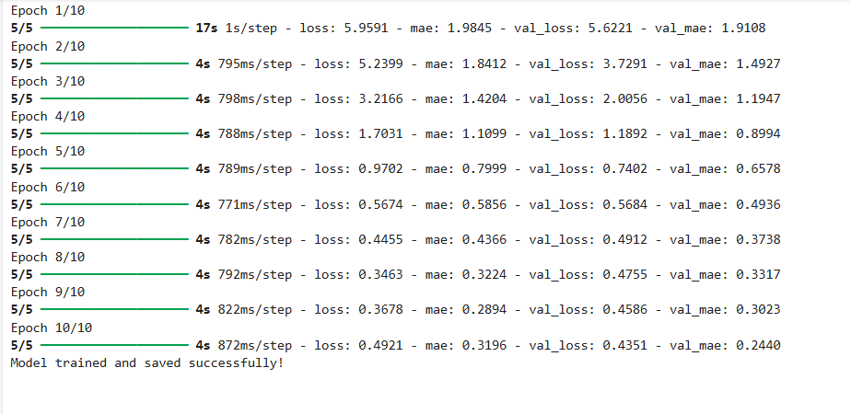
Model Creation part 11
Dataset requirement?
Format of documents
Grading Rubrics
Quantity and quality of data

Slide 10
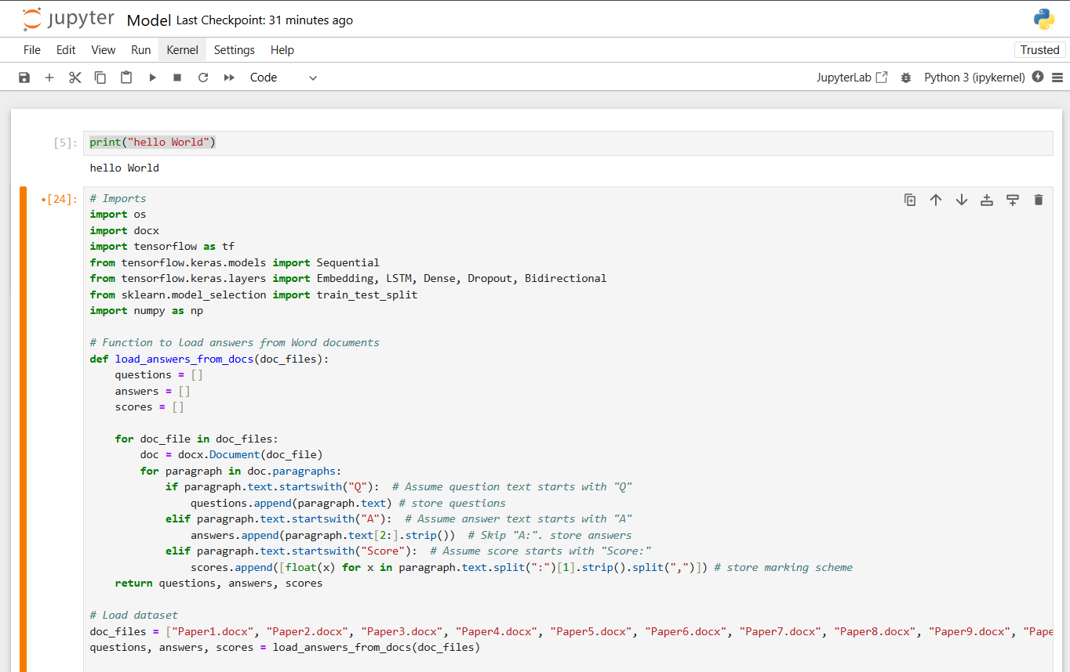
Project README
How to set up my project?
Jupyter notebook
Ipynb file
Order of operations
Future?

Slide 11
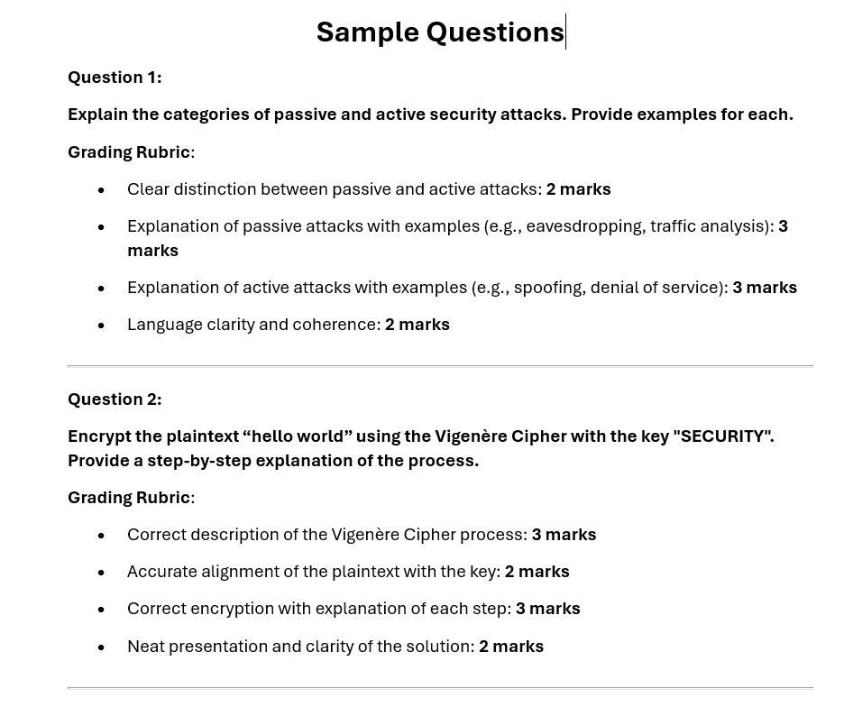
Existing model for Demo
What is my model for my demo?
Sample exam paper
Docx file format
20 questions
10 marks each

Slide 12
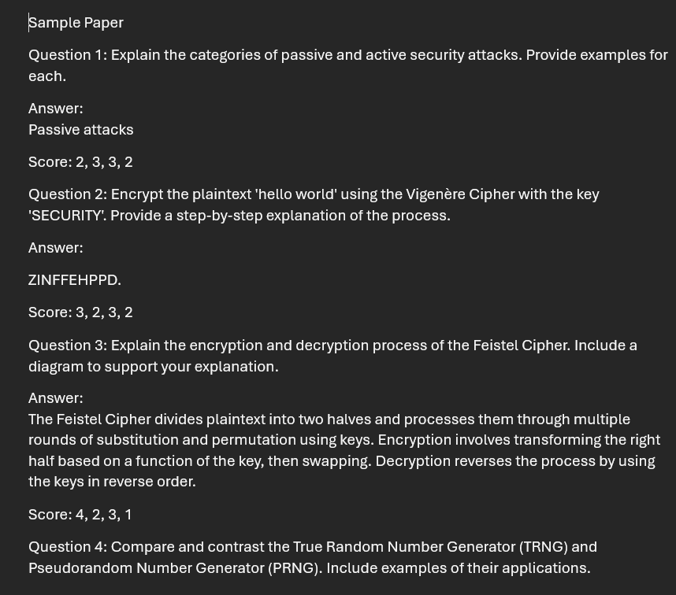
Usage of existing model
What am I using to demonstrate my model?
Testanswer.docx
essay_grading_model.keras
Metrics to score

Slide 13
Future ai component
How does the ai work?
Paper, grading scheme, and results
Human customized feedback
Why I want this feedback?
Student starts the program
Student chooses what question they are answering
student inputs their answer
The system grades their answe
The system sends the result, rubric and essay to the AI
The AI generates feedback and translates the result
The system skips the AI if it doesn't work
The results and feedback is displayed to the user

Slide 14
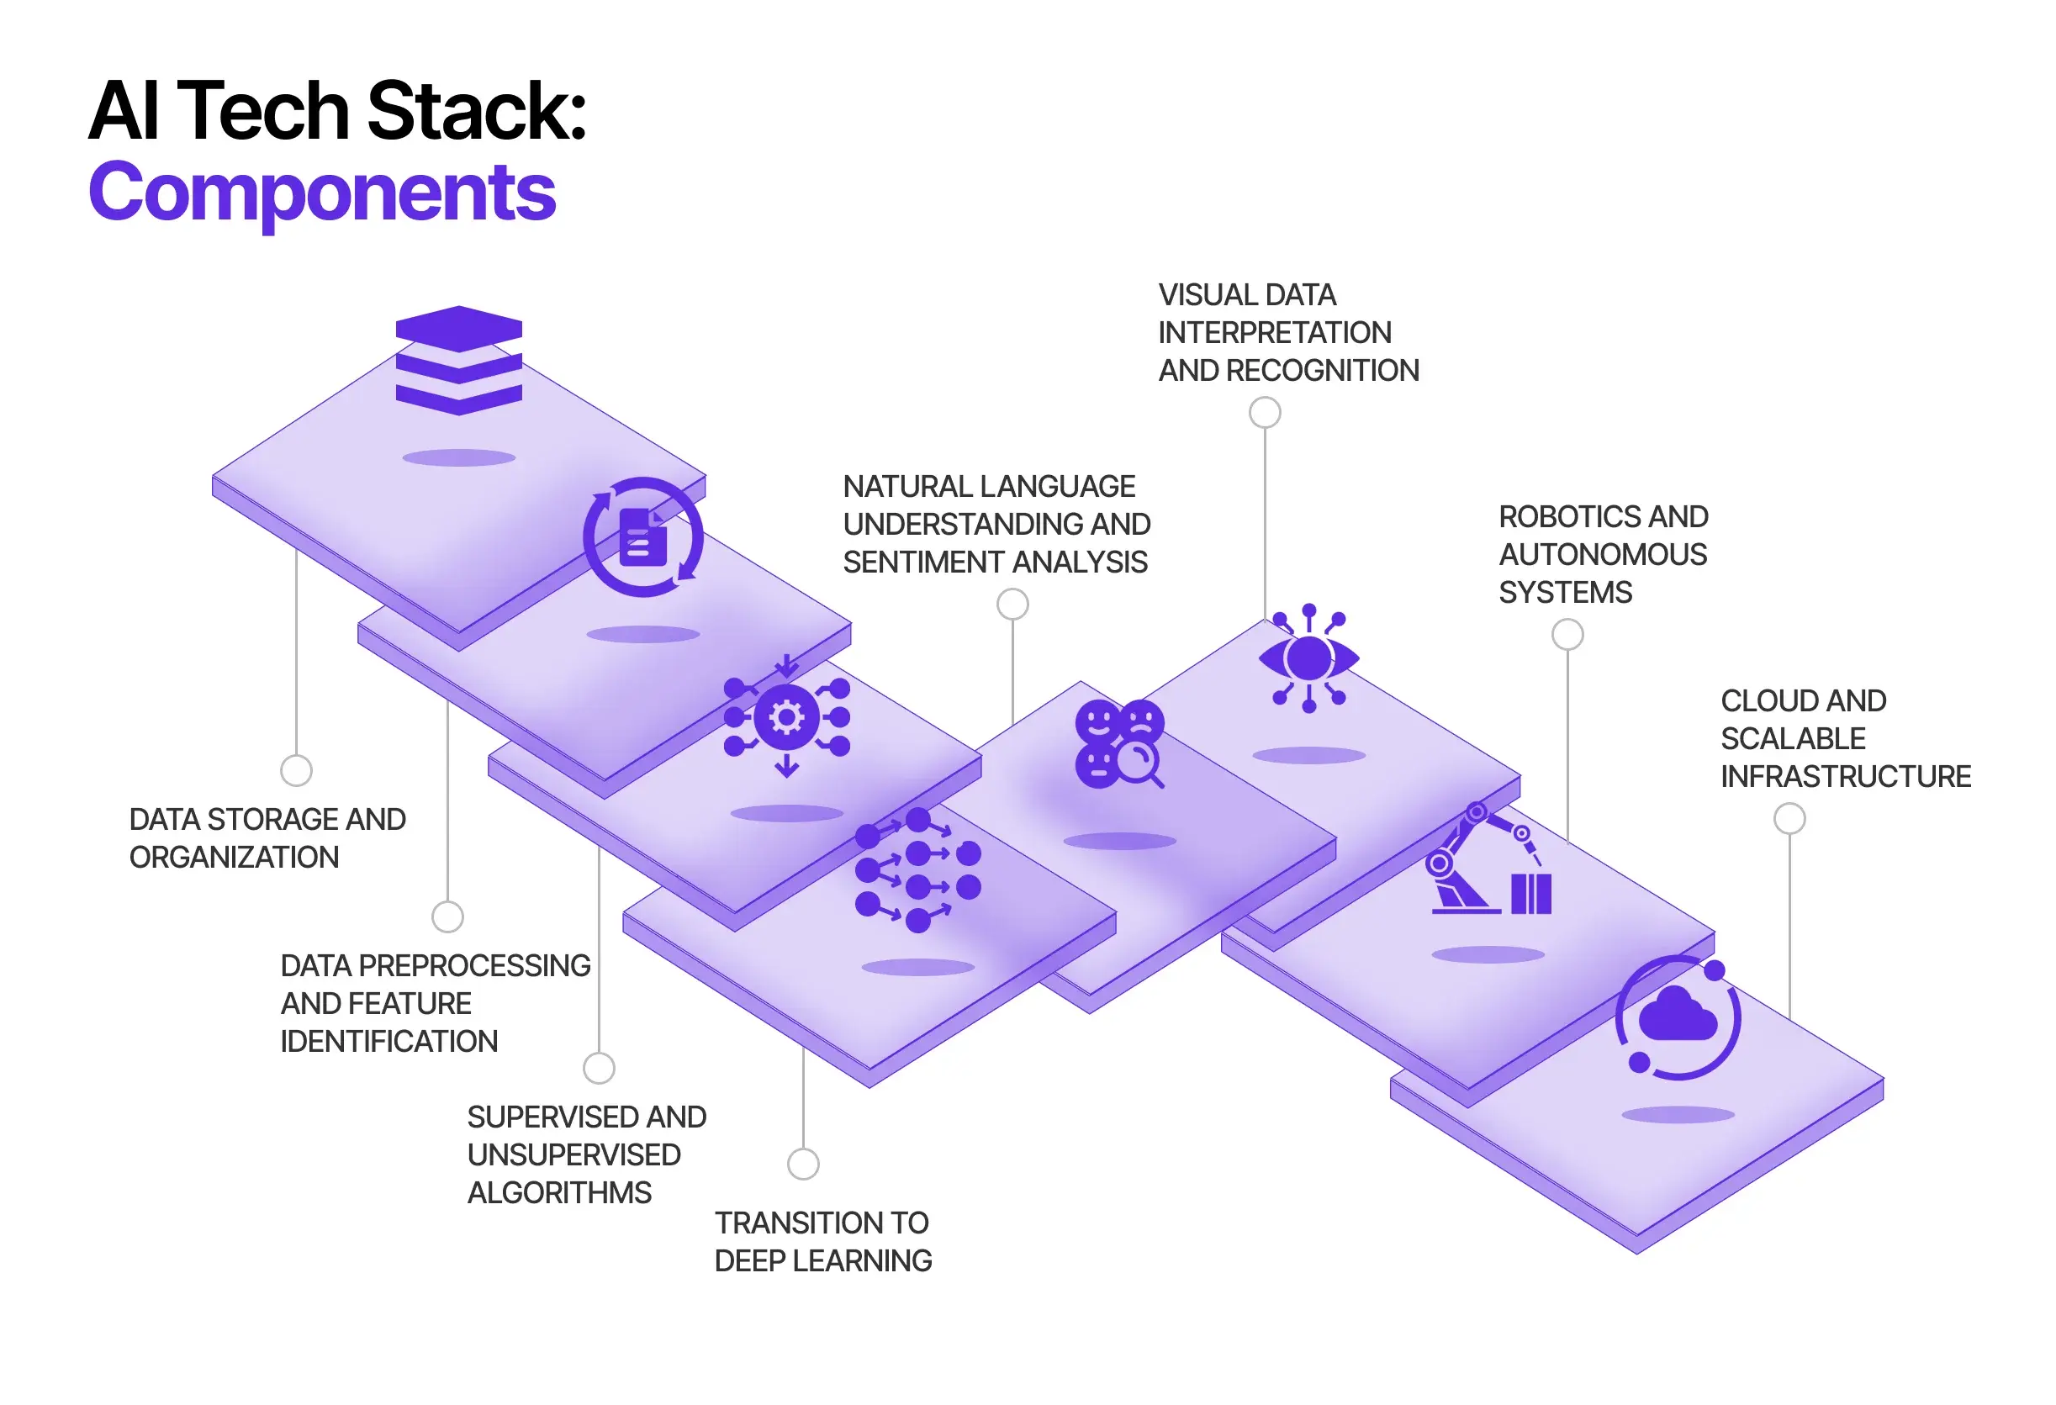
Technology Stack
Python
Tensorflow
Docx
Scikit-Learn
NumPy

Slide 15
Demonstration

Slide 16
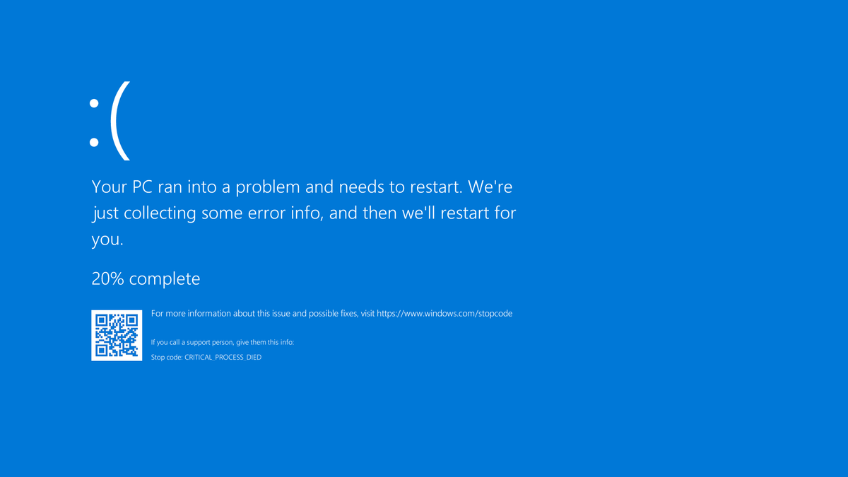
Challenges
Scalability
Reliability
Data generation
Validation testing
AI

Slide 17

Future possibilities
Mobile application
Increased models
Better datasets
Real-life exam papers

Slide 18
Thank you for listening
Any Questions?

